Slide 1
Identifying Potential Driver Mutations for Squamous Cell Carcinomas Using TCGA Data
Data Incubator Project Proposal
Eric Jaehnig
May 11, 2017

Slide 2
Cancer Kills…
Over 600,000 estimated deaths in 2017 in U.S.
2nd most common cause of death
Source: American Cancer Society
Mutations & Cancer
Mutations in genes drive cancer progression
Activate oncongenes (Myc)
Inactivate tumor suppressors (p53)
Identifying mutations critical for understanding causes and identifying biomarkers and drug targets

Slide 3
The Cancer Genome Atlas (TCGA) & Squamous Cell Carcinomas (SCCs)
TCGA
150 Cancer ‘omic Studies
All contain genomic mutation data from tumors
11 studies focused on SCCs
Total of 2200 patients
Mutations in over 17,000 genes
Challenge: determining which mutations are drivers
SCCs
Cancers arising from squamous (flat) epithelial cells
Includes skin, cervical, esophageal, lung, and head and neck cancers
Same cell type in wide variety of tissues and locations
Genes mutated in all likely drivers

Slide 4
Strategy:
Determine which genes are mutated in all SCC studies
Signal-to-noise: focus on drivers not passengers
Which pathways are these genes in?
Clustering to identify similarities and differences between different types of SCCs
Are specific types more similar to each other?
What genes underlie these similarities and differences?
Use patient prognosis data to determine differences between patients with good and poor prognosis
Machine-learning classification of gene mutations (i.e., PCA)

Slide 5
Strategy:
Determine which genes are mutated in all SCC studies
Signal-to-noise: focus on drivers not passengers
Which pathways are these genes in?
Clustering to identify similarities and differences between different types of SCCs
Are specific types more similar to each other?
What genes underlie these similarities and differences?
Use patient prognosis data to determine differences between patients with good and poor prognosis
Machine-learning classification of gene mutations (i.e., PCA)

Slide 6
Plot 1: 193 Unique Genes are Mutated in All 5 SCCs

Slide 7
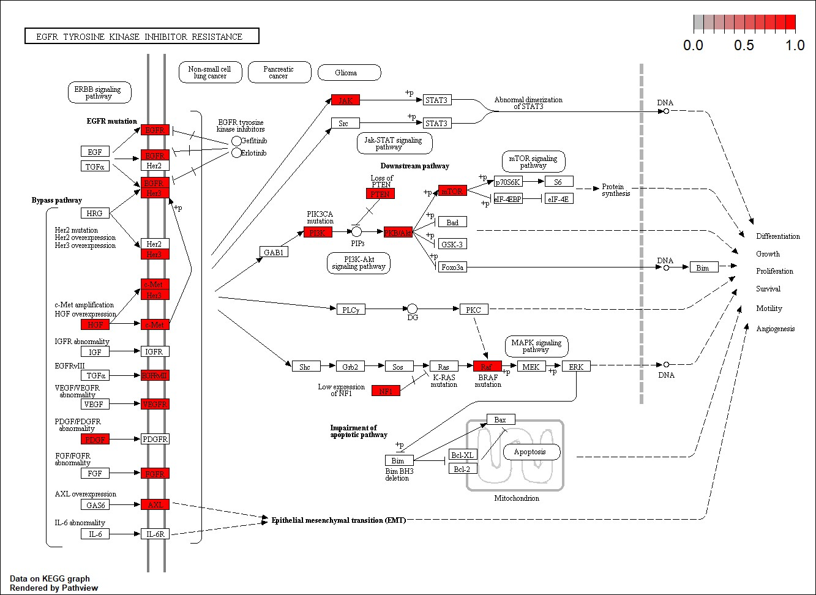
Plot 2: Enrichment for Genes in EGFR TK Inhibitor Resistance Pathway

Slide 8
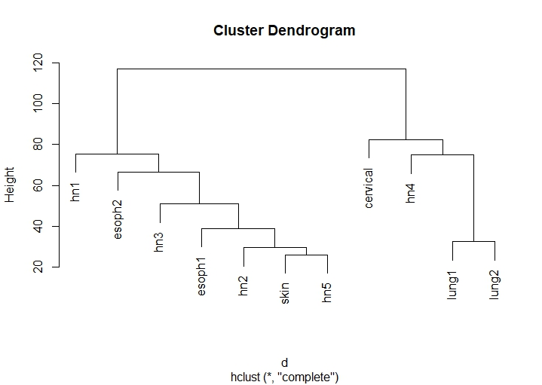
Plot 3: Hierarchical Clustering of TCGA Samples

